Slide 1
Coursera capstone project
IBM Data Science Certification
Ateet Mehta

Slide 2
Report Content
Introduction Section
Data Section
Methodology Section
Results Section
Discussion Section
Conclusion Section

Slide 3
Introduction
Scenario and Background
I am a data scientist currently residing in Downtown Singapore. I currently live within walking distance to Downtown "Telok Ayer MRT metro station" therefore I have access to good public transportation to work. Likewise, I enjoy many amenities in the neighborhood , such as international cuisine restaurants, cafes, food shops and entertainment. I have been offered a great opportunity to work in Manhattan, NY. Although, I am very excited about it, I am a bit stress toward the process to secure a comparable place to live in Manhattan. Therefore, I decided to apply the learned skills during the Coursera course to explore ways to make sure my decision is factual and rewarding. Of course, there are alternatives to achieve the answer using available Google and Social media tools, but it rewarding doing it myself with learned tools.
Problem to be resolved:
The challenge to resolve is being able to find a rental apartment unit in Manhattan NY that offers similar characteristics and benefits to my current situation. Therefore, in order to set a basis for comparison, I want to find a rental unit subject to the following conditions: Apartment with min 2 bedrooms with monthly rent not to exceed US$7000/month
Unit located within walking distance (<=1.0 mile, 1.6 km) from a subway metro station in Manhattan
Area with amenities and venues similar to the ones described for current location ( See item 2.1)
Interested Audience
I believe this is a relevant project for a person or entity considering moving to a major city in Europe, US or Asia, since the approach and methodologies used here are applicable in all cases. The use of FourSquare data and mapping techniques combined with data analysis will help resolve the key questions arisen. Lastly, this project is a good practical case toward the development of Data Science skills.

Slide 4
Data Section
Data of Current Situation
I Currently reside in the neighborhood of 'Mccallum Street' in Downtonw Singapore. I use Foursquare to identify the venues around the area of residence which are then shown in the Singapore map shown in methodology and execution in section 3.0 . It serves as a reference for comparison with the desired future location in Manhattan NY
Data Required to resolve the problem
In order to make a good choice of a similar apartment in Manhattan NY, the following data is required: List/Information on neighborhoods form Manhattan with their Geodata ( latitud and longitud. List/Information about the subway metro stations in Manhattan with geodata. Listed apartments for rent in Manhattan area with descriptions ( how many beds, price, location, address) Venues and ammenities in the Manhattan neighborhoods (e.g. top 10) 2.3 sources and manipulation The list of Manhattan neighborhoods is worked out during LAb exercise during the course. A csv file was created which will be read in order to create a dataframe and its mapping. The csv file 'mh_neigh_data.csv' has the following below data structure. The file will be directly read to the Jupiter Notebook for convenience and space savings. The clustering of neighborhoods and mapping will be shown however. An algorythm was used to determine the geodata from Nominatim . The actual algorythm coding may be shown in 'markdown' mode becasues it takes time to run.
How the data will be used to solve the problem
The data will be used as follows: Use Foursquare and geopy data to map top 10 venues for all Manhattan neighborhoods and clustered in groups ( as per Course LAB) Use foursquare and geopy data to map the location of subway metro stations , separately and on top of the above clustered map in order to be able to identify the venues and ammenities near each metro station, or explore each subway location separately Use Foursquare and geopy data to map the location of rental places, in some form, linked to the subway locations. create a map that depicts, for instance, the average rental price per square ft, around a radious of 1.0 mile (1.6 km) around each subway station - or a similar metrics. I will be able to quickly point to the popups to know the relative price per subway area. Addresses from rental locations will be converted to geodata( lat, long) using Geopy-distance and Nominatim. Data will be searched in open data sources if available

Slide 5
Methodology Section
The analysis and the strategy:¶
The strategy is based on mapping the above described data in section 2.0, in order to facilitate the choice of at least two candidate places for rent. The choice is made based on the demands imposed : location near a subway, rental price and similar venues to Singapore. This visual approach and maps with popups labels allow quick identification of location, price and feature, thus making the selection very easy.
The processing of these DATA and its mapping will allow to answer the key questions to make a decision:
what is the cost of available rental places that meet the demands?
what is the cost of rent around a mile radius from each subway metro station?
what is the area of Manhattan with best rental pricing that meets criteria established?
What is the distance from work place ( Park Ave and 53 rd St) and the tentative future rental home?
What are the venues of the two best places to live? How the prices compare?
How venues distribute among Manhattan neighborhoods and around metro stations?
Are there tradeoffs between size and price and location?
Any other interesting statistical data findings of the real estate and overall data.

Slide 6
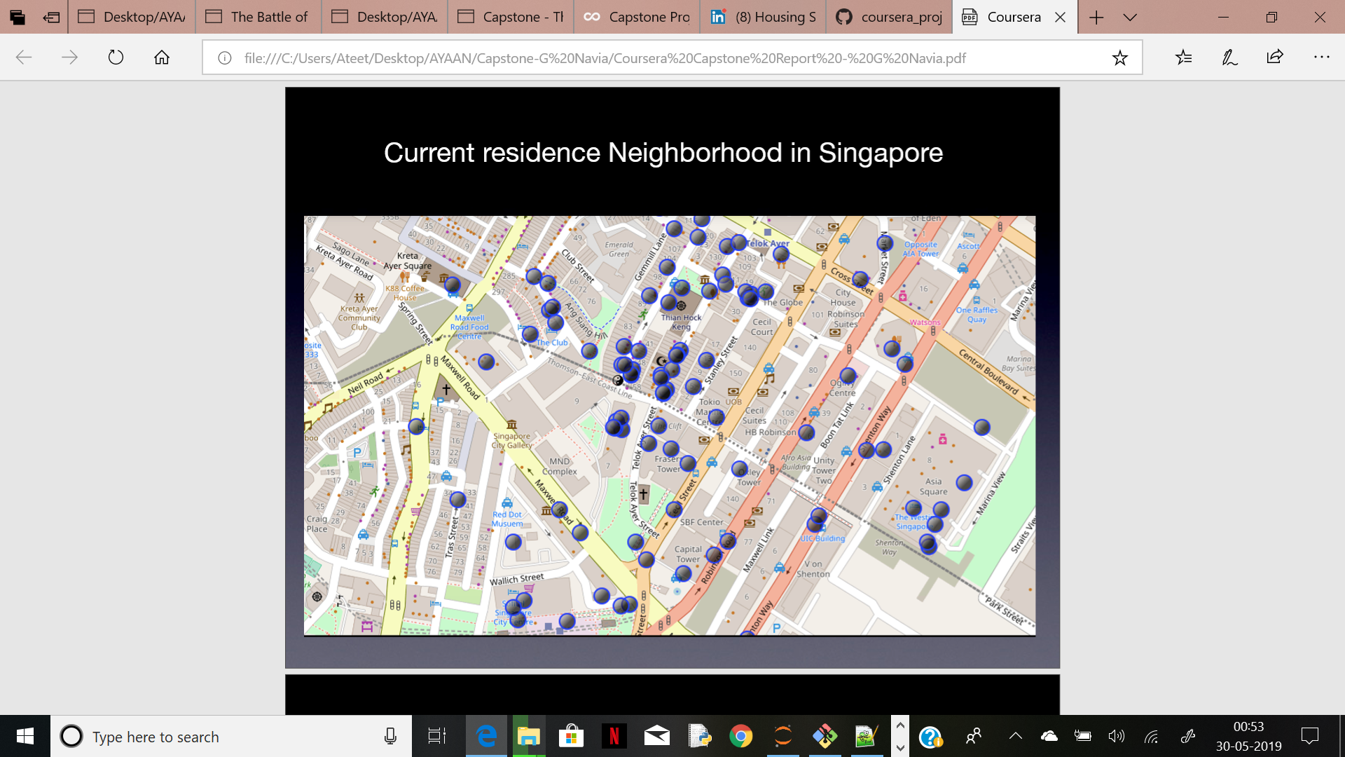
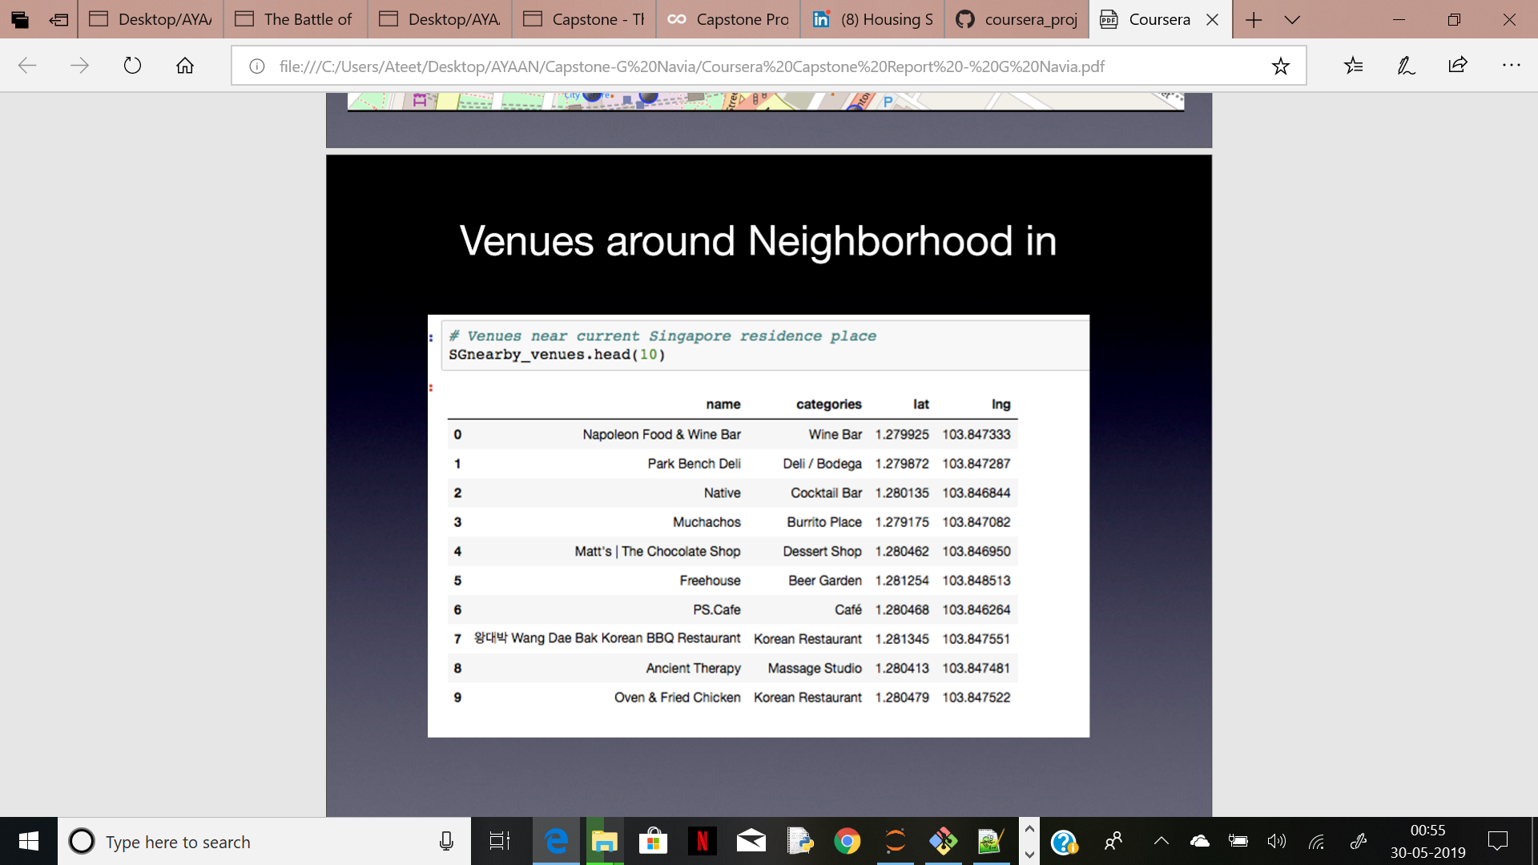
Execution and Results

Slide 7
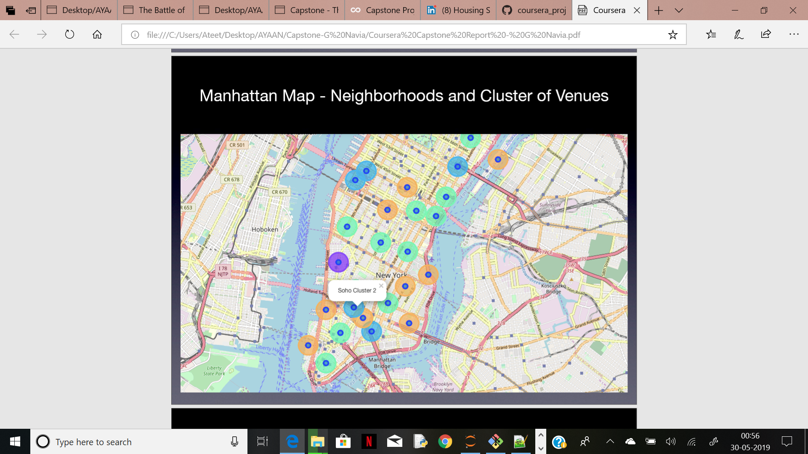
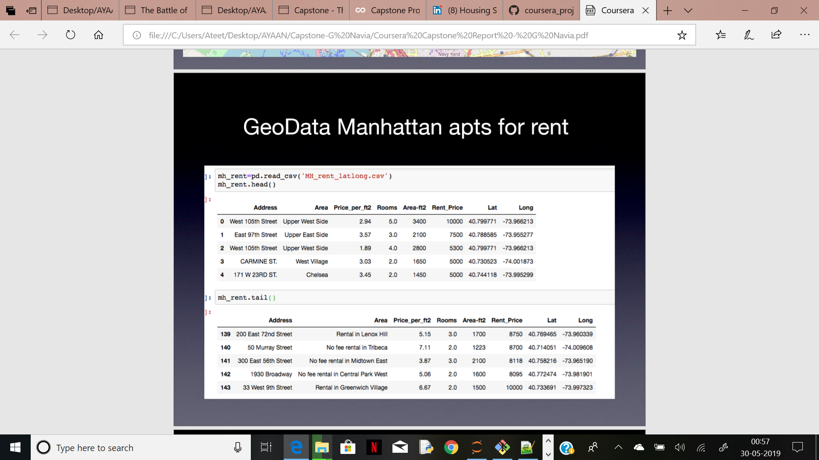

Slide 8
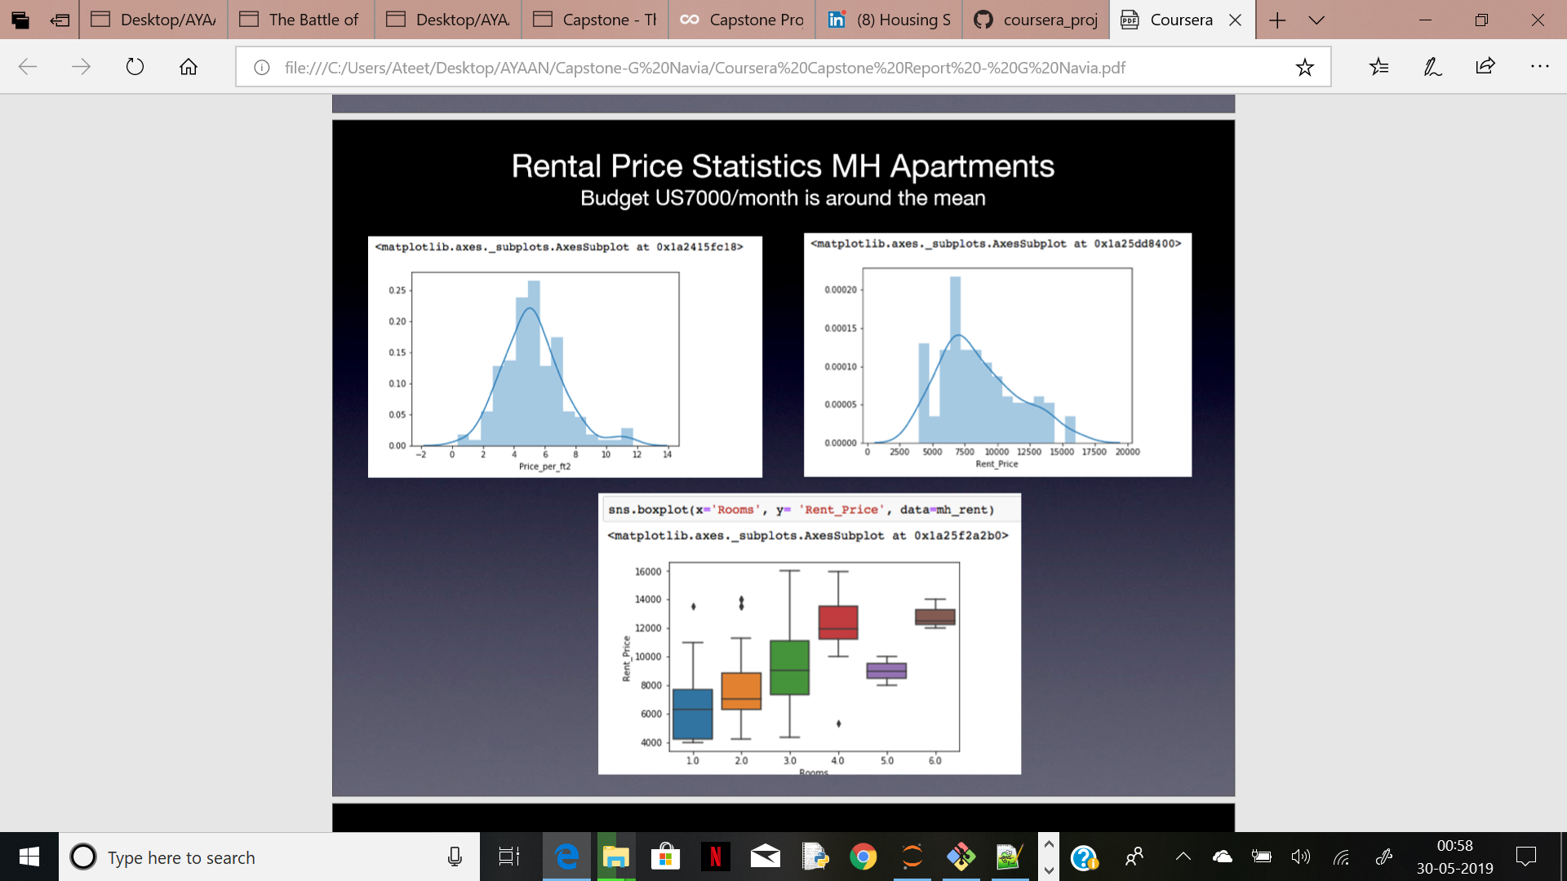
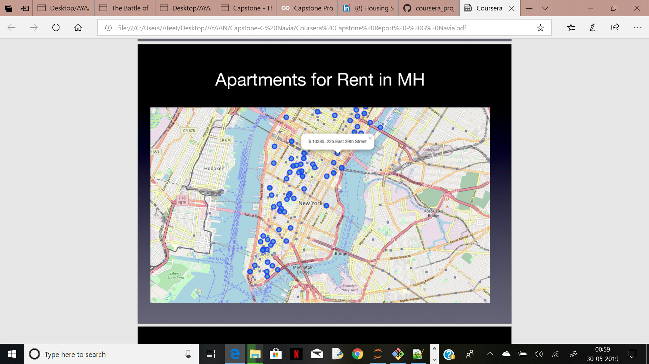

Slide 9
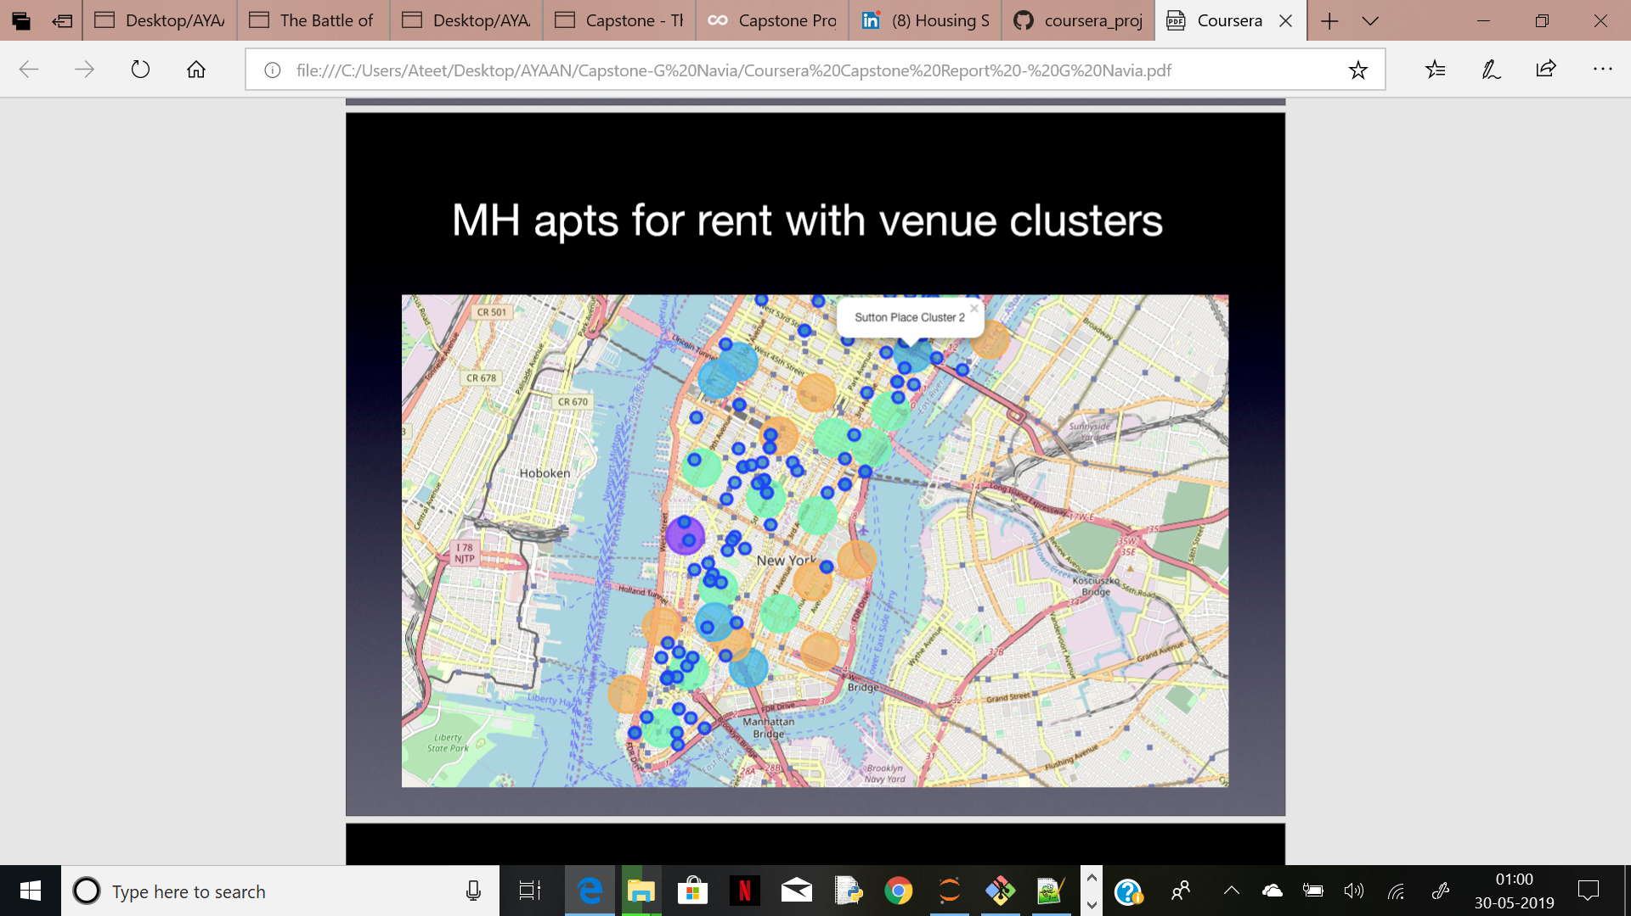
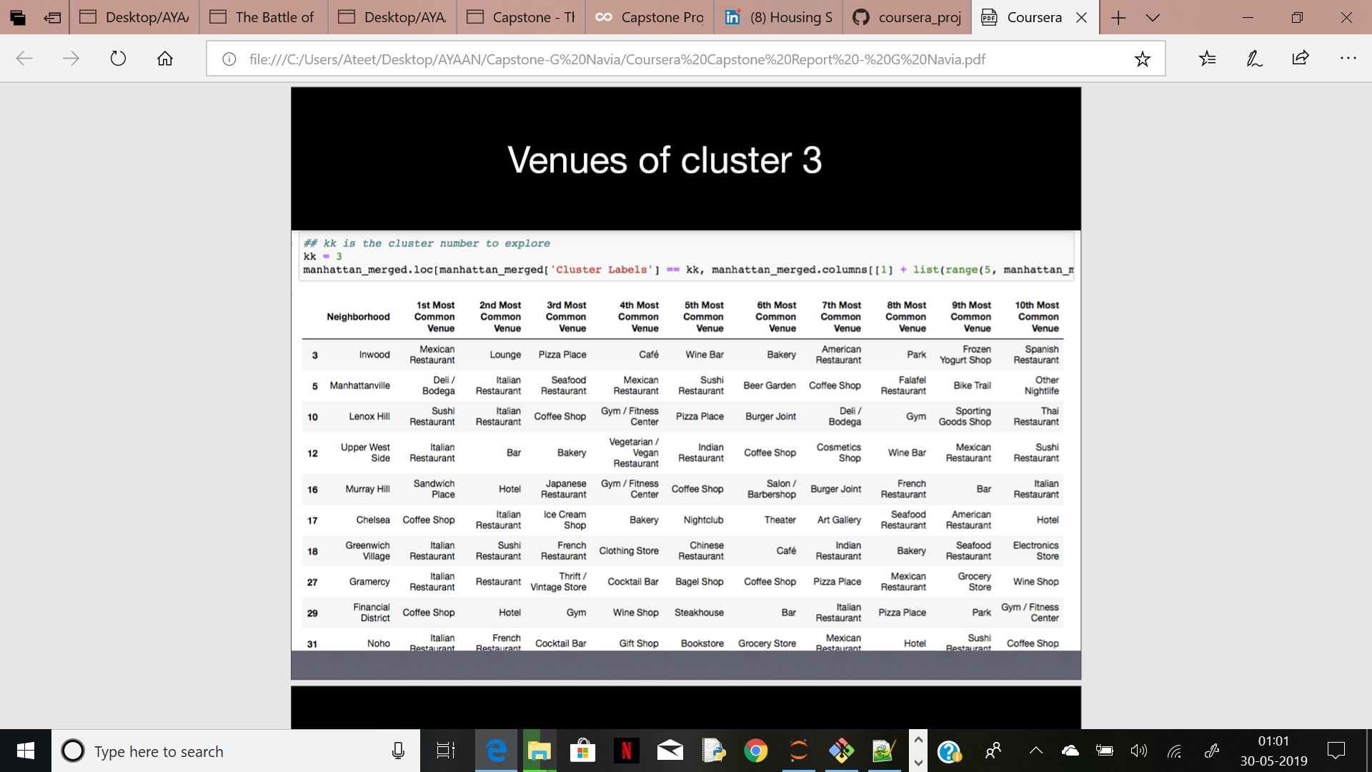

Slide 10
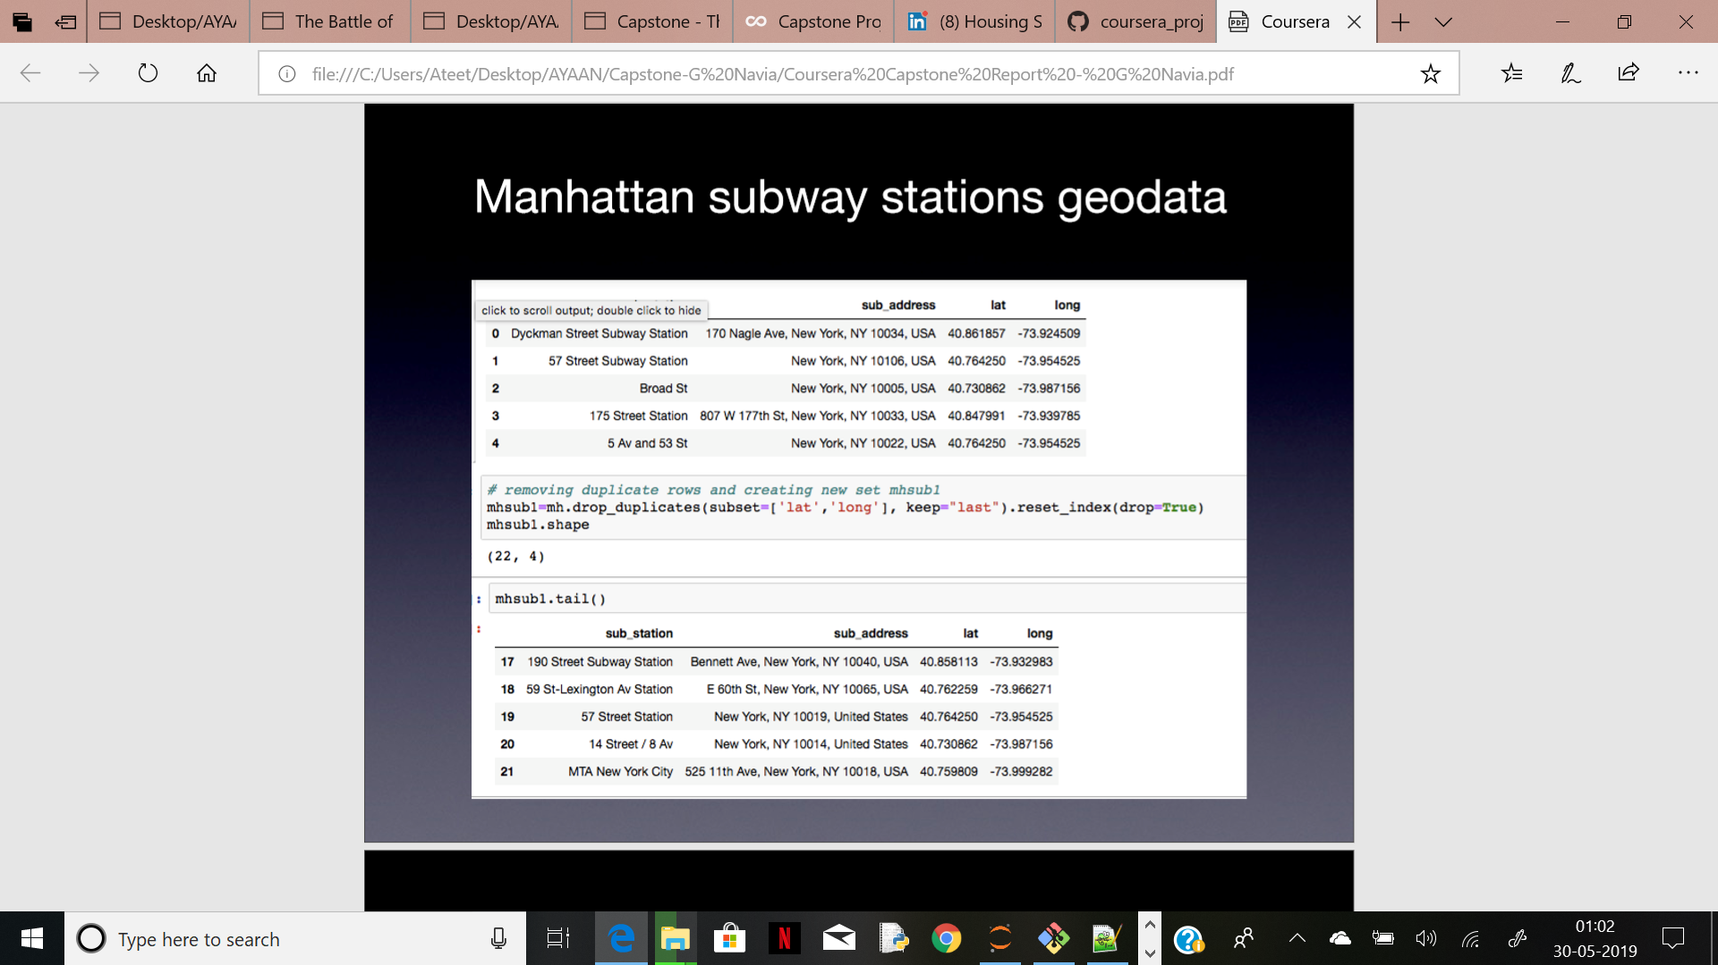
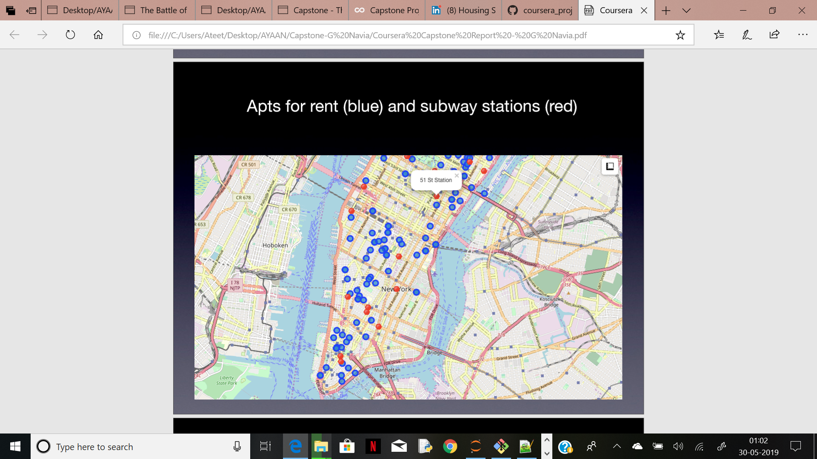

Slide 11
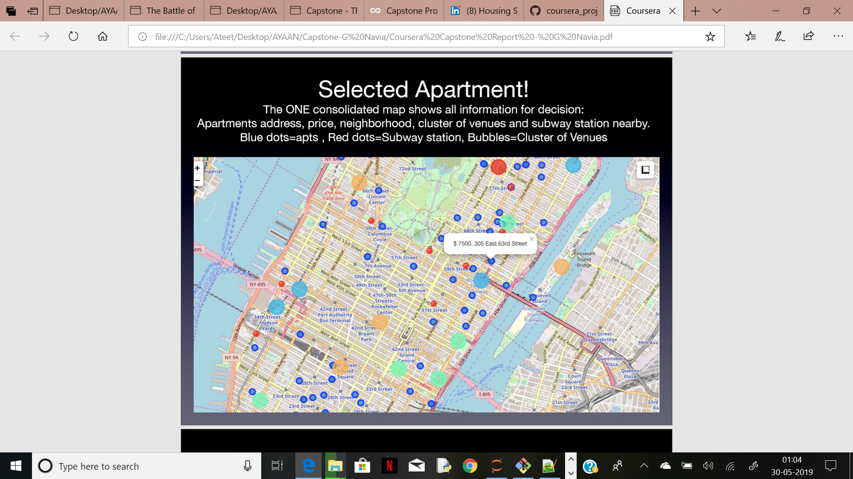
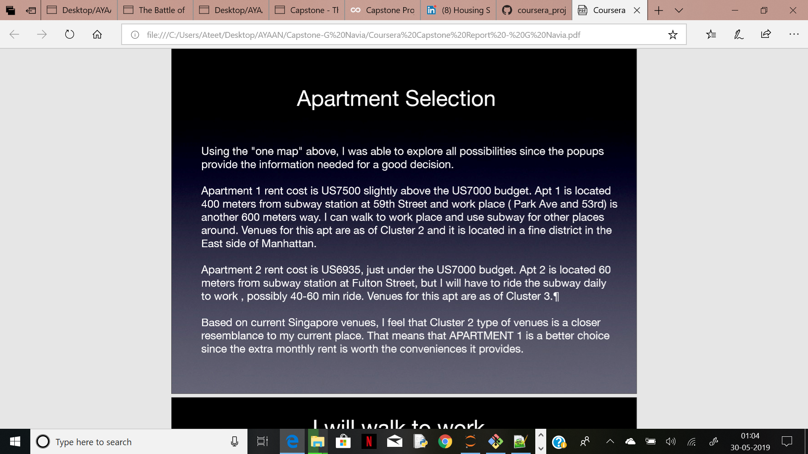

Slide 12
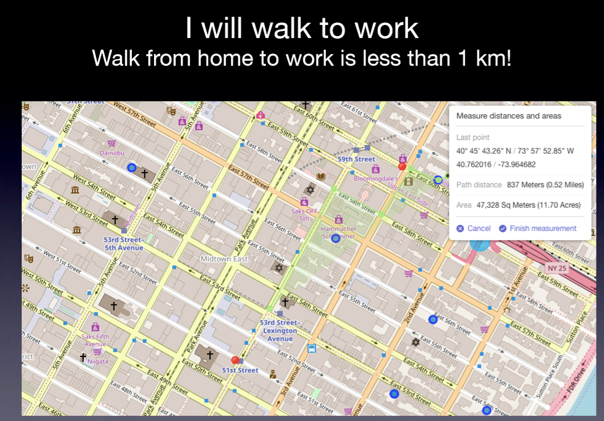

Slide 13
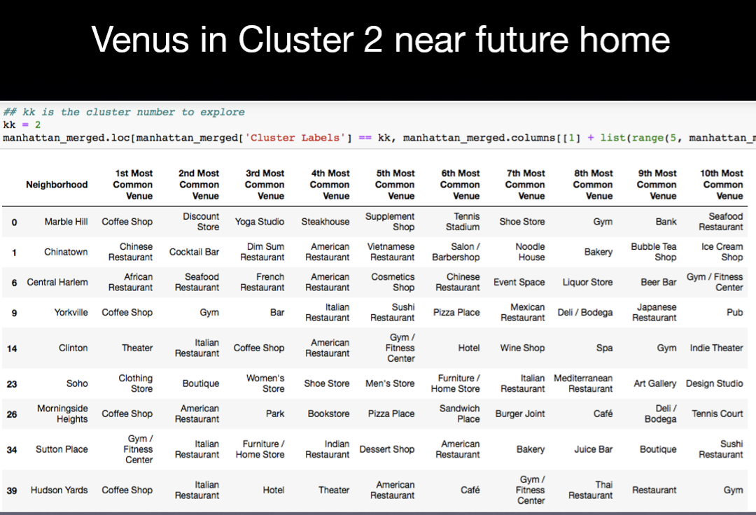

Slide 14
Discussion
First of all, it was an extremely joyful and enriching experience to get into a data science through this outstanding course offered on Coursera / IBM. I am greatly pleased and equally impressed with the overall organization, content and lab works presented during the Coursera IBM Certification Course.
I feel this Capstone project presented me a great opportunity to practice and apply the Data Science tools and methodologies learned.
I have created a good project that I can present as an example to show my potential.
I feel I have acquired a good starting point to become a professional Data Scientist and I will continue exploring to creating examples of practical cases.

Slide 15
Conclusion
Without any doubt, I am going to recommend this coursera to my colleagues and friends who i know are looking forward to get into Data Science.
I certainly feel rewarded with the efforts, time and money spent. I believe this course with all the topics covered is well worthy of appreciation.
This project has shown me a practical application to resolve a real situation that has impacting personal and financial impact using Data Science tools.
The mapping with Folium is a very powerful technique to consolidate information and make the analysis and decision thoroughly and with confidence.
I would recommend for use in similar situations.
One must keep abreast of new tools for DS that continue to appear for application in several business fields
Big Big Big Thanks to Coursera Team!!!
Have a great learning!!!

